Slide 1

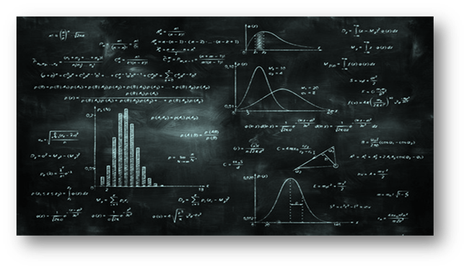
Business Analytics at UCSD
Raymond Pettit, Executive Director
Master of Science in Business Analytics Rady School of Management @ UCSD

Slide 2
The RADY MSBA is Data Science for Business
Data and analytics are everywhere in business
Rady’s MSBA program is preparing the next generation of data scientists trained in applied business solutions and insight generation
Rady MSBA is here to offer a significant scholarship to the winning team in today’s business track competition

Slide 3
The “information explosion”
There is no question, the importance of data analytics is on the rise – and it will only grow in relevance as tools and technology that collect data become more ubiquitous and mind-bogglingly sophisticated. Consider these facts:
The data volumes are exploding, more data has been created in the past two years than in the entire previous history of the human race
Data is growing faster than ever before and by the year 2020, about 1.7 megabytes of new information will be created every second for every human being on the planet.
By 2020, we will have over 6.1 billion smartphone users globally (which in turn, will produce even more data)
And here’s the kicker: at the moment less than 0.5% of all data is ever analyzed and used
The Chief Analytics Officer (CAO) Forum Global Roundtable
https://coriniumintelligence.com/wp-content/uploads/2016/11/CAO-Roundtable-Corinium-final.pdf
Notes:
Source: https://coriniumintelligence.com/wp-content/uploads/2016/11/CAO-Roundtable-Corinium-final.pdf
Relatively new titles or roles: CAO or CDO

Slide 4
Companies know more about their customers than ever before
THE INFORMATION TRAIL WE LEAVE
Credit card transactions
Travel (e.g., TSA)
Online purchases
Web surfing
Audio/video streaming
Reactions to mail/e-mail offers
Customer support calls
Self-provided information on preferences, income, demographics
Location information
Usage information (IOT)
Social network posts and links
Notes:
Travel (phone or scanning or login from non-standard location)
Customer support calls are automatically trans-scribed
Location information collected by your phone / GPS (Q: Anyone *not* accept that when requested?)
Usage information (sensors) – IOT (e.g., HP on printer usage, Cisco managing data collection for others as a service).
IOT: Companies still trying to figure out how to use this most effectively for customer and company benefit
How can all this data be used? Well, one view is …
TSA – Transportation Security Administration

Slide 5
Why the increased interest in MSBA?
The skills companies need most today
Cloud and Distributed Computing
Statistical Analysis and Data Mining
Middleware and Integration Software
Web Architecture and Development Framework
User Interface Design
Software Revision Control Systems
Data Presentation
SEO/SEM Marketing
Mobile Development
Network and Information Security
Notes:
The Information explosion has had an incredibly important effect on marketing and business. There is HUGE demand for these skills
This is the student perspective on why this is important
“I am a worried about the technical aspects but I know I MUST have these skills”
Recent LinkedIn article “36% of business roles with ‘data science’ in the job description are held by people with MSBA degrees.”

Slide 6





Customer information can be extremely useful for both the company AND the customer
USES OF CUSTOMER INFORMATION
Grade customers
Calculate customer value to the organization
Increase customer loyalty
Delight customers with relevant knowledge
Intervene to prevent customer attrition
Develop models which predict “early signs” of customer dissatisfaction
Target interested customers
Notes:
There is the danger of abuse, of course, and companies can getting really creepy with the data or spam without mercy …
Grading
Anyone grade or score customers on the job?
Marketing has limited resources so needs to focus … and possibly “fire” their bad customers. Heard of that before?
BNY Mellon banking and financial services company … e.g., shorter wait times for most valued customers
Neiman Marcus … fashion shows for highest tier customers
Airlines loyalty programs (Alaska airlines has a highly rated program)
Increase loyalty:
International wire-transfer anyone? A hassle! Why should it be? I you have done this before it is *still* a hassle. No interest in making this easier even though they have data on you.
Amazon.nl ... can login and have relevant information
Already bought that book
Intervene:
Customer attribution or churn is a **huge** deal in many industries (e.g., subscription based biz like cell phone plans)
Most important use of analytics at nationwide (insurance)
Target:
Cleversafe (Chicago based), second largest data storage company in the world after EMC. e.g., Shutterfly is their client. “Object oriented” storage, less redundancy for the same level of security
At the moment there are about 14,000 people/companies that are interested in buying their PETA-bite systems. They built systems to know everyone that comes to their website. Is person interested in cost effectiveness or security? Salespeople will call the same day. Every dollar of revenue tied to every interaction of every person. When they buy internet data they only buy from websites that can target one of these 14,000 people.
Unfortunately doing these things well can be hard to pull off
----------
E.g., Target knows about woman being pregnant before … parents … well sort of
http://www.slate.com/blogs/how_not_to_be_wrong/2014/06/09/big_data_what_s_even_creepier_than_target_guessing_that_you_re_pregnant.html
http://video.foxnews.com/v/1470704607001/target-knew-teen-was-pregnant-before-her-dad/?#sp=show-clips

Slide 7
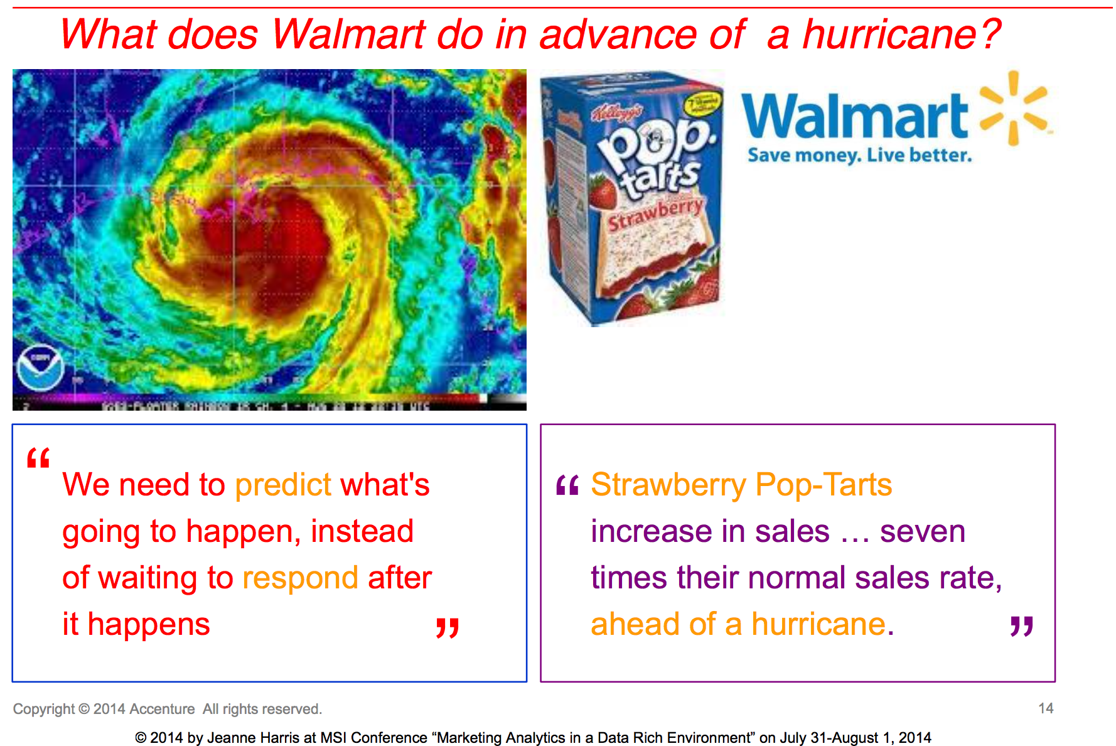

Putting Predictive Analytics to Work
Uses regression analysis to predict/guess based on historical data
Notes:
The media also really likes talking about this topic ...
But how are companies using data?

Slide 8
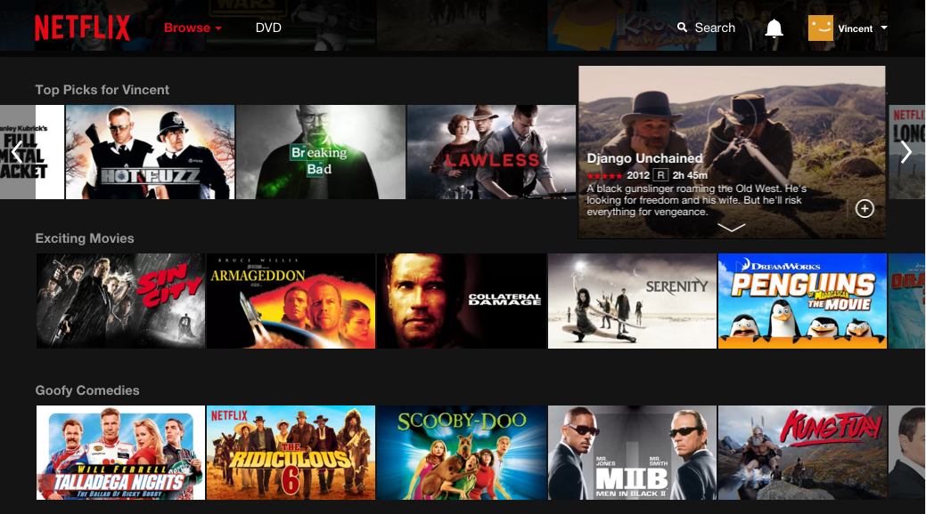
Determining Netflix Recommendations
An engineering approach
Content analysis and classification
Match your choices and viewing actions
Recommender System
No more surveys !!
https://www.theatlantic.com/technology/archive/2014/01/how-netflix-reverse-engineered-hollywood/282679/
Notes:
Netflix uses pirate sites to determine what shows to buy.
Video streaming giant Netflix sees itself as one of the most prominent competitors to the many pirate sites that offer video content without owners’ permission.
One of the shows that Netflix acquired the rights to in the Netherlands is Prison Break, since it is heavily pirated locally. “Prison Break is exceptionally popular on piracy sites,” Merryman says.

Slide 9
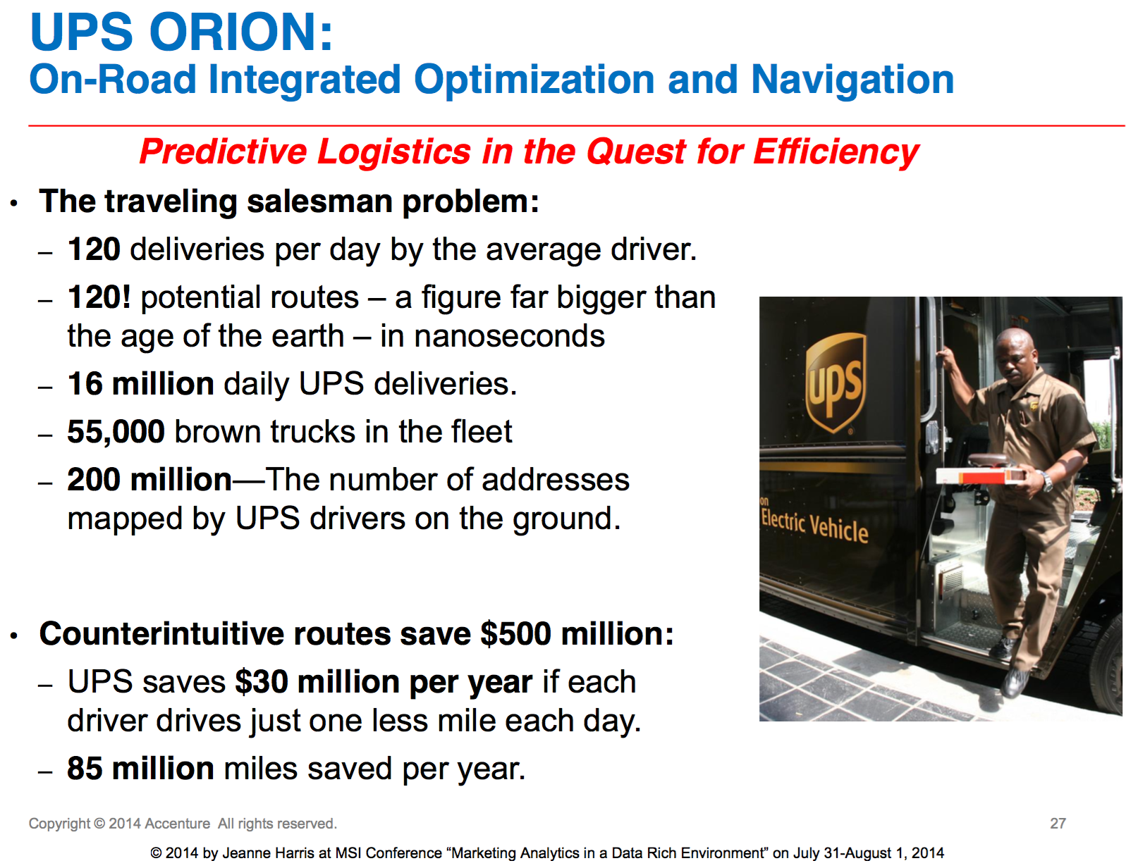
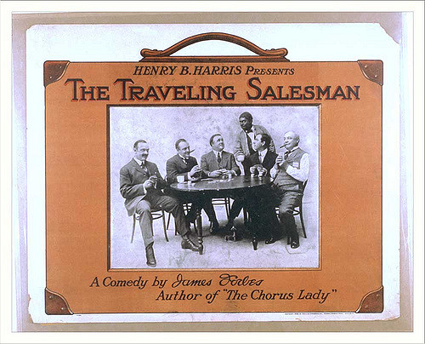
Improving Business Logistics and Operations
Uses a form of regression that calculates all possible routes and ‘chooses’ the best ones
Notes:
BA optimization

Slide 10
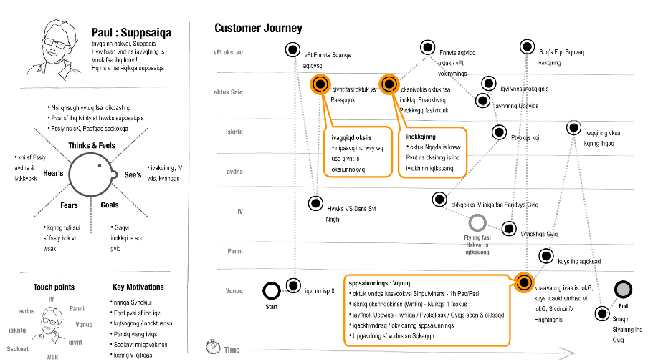
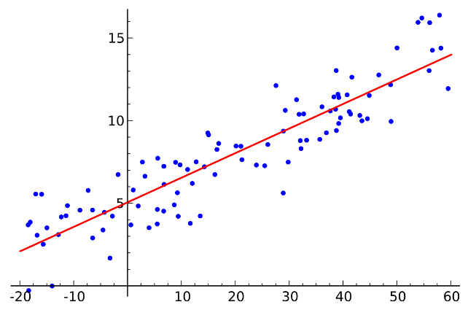
Knowing the customer vs. capturing patterns
Nike Example
Customer ‘journey’
Data Science ‘lens’
What the business ‘sees’:
What the data scientist ‘sees’:

Slide 11
“Analytics” Needs Substantial Support
Business Analytics needs a substantial data support platform
https://hackernoon.com/the-ai-hierarchy-of-needs-18f111fcc007

Slide 12


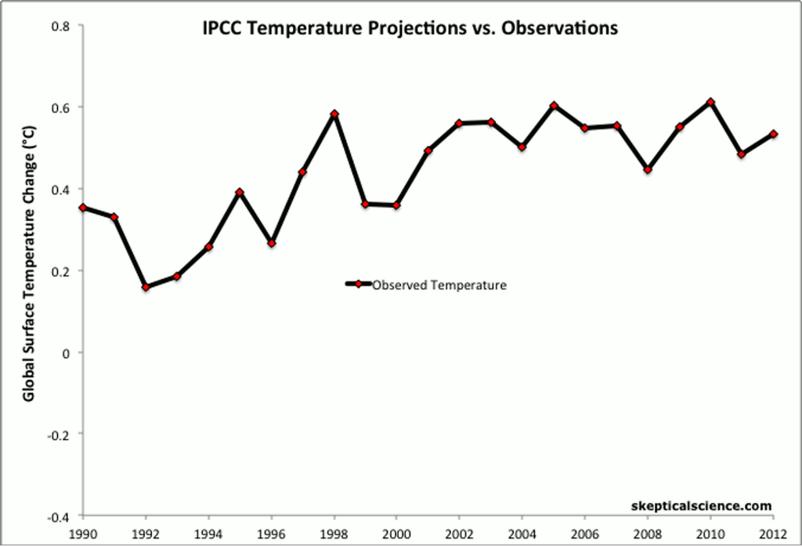

What Business Analytics (MSBA) Focuses on
DESCRIPTIVE ANALYTICS
Learning about your data and your environment
Tools: Calculate summary statistics and plot your data
PREDICTIVE
ANALYTICS
Predicting the future
Use models and data you already have to generate “information” you don’t
Tools: Regression, Decision Trees, Neural Networks
PRESCRIPTIVE
ANALYTICS
What should you do?
Use input from previous steps to generate recommendations and help a human make a decision
Tools: Simulation, Decision rules, Optimization
ARTIFICIAL INTELLIGENCE
DYNAMIC PRESCRIPTIVE ANALYTICS
A closed loop system where new data is collected and processed to update predictions and prescriptions. If the context is sufficiently constrained and the decision model sufficiently rich the human can be removed from the loop.
Notes:
AI vs machine learning: https://medium.com/datadriveninvestor/differences-between-ai-and-machine-learning-and-why-it-matters-1255b182fc6
AI needs lots of data and a narrow context: https://scet.berkeley.edu/artificial-intelligence-and-the-rumsfeld-test/
Autonomous driving: https://medium.com/@jonathan_hui/self-driving-car-path-planning-to-maneuver-the-traffic-ac63f5a620e2

Slide 13
Rady MSBA Prize Award
"A scholarship for the UCSD/Rady MSBA program in the amount of $30,000 will be awarded to each member of the winning team in the DataHacks 2020 Business Track Contest*.
The prize is contingent on successful completion of UCSD Graduate applications and admittance policies and requirements.
*maximum of three students
Note: This prize has no cash value other than a fellowship to defray the annual tuition cost of the UCSD/Rady MSBA program. The prize is eligible to be redeemed either the fall after the student graduates or the next fall after that

Slide 14
Applying for the MSBA Program
Deadlines: Apr 1 (International) – June 1, 2020
Applications reviewed on a rolling basis
Contact: Rady School Graduate Admissions Office: 858.534.0864 or radygradadmissions@ucsd.edu
Apply directly online at rady.ucsd.edu/msba
UCSD graduates receive an immediate $10,000 reduction in program costs.

